Slide 1
Data Science
presentation by Alena Mclucas

Slide 2
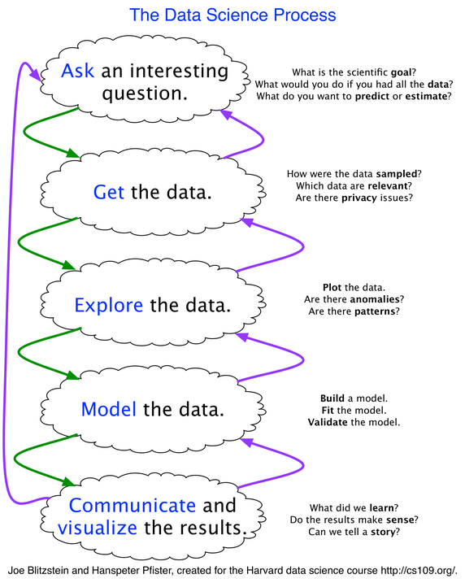
Data Science Steps
Jump to:
Ask questions
Get the data
Explore the data
Model the data
Communicate and visualize the results

Slide 3
Ask Questions
Rely on domain knowledge
Ask the right people for input (across departments/expertise)
Come up with many questions, shave down to the most impactful
Set metrics, expectations, align with business/scientific objectives
…

Slide 4
Data Collection (Get the Data)
This can include processes like:
Downloading a csv/xls
Querying a database
Web scraping
…
Importing all datasets

Slide 5
Data Exploration (Explore the Data)
This includes:
Variable definitions
Visualizations
Univariate and bivariate analysis
Pivot tables
Note patterns and anomalies
Guided by domain knowledge

Slide 6
Data Exploration

Slide 7
Data Exploration
Data exploration is about describing the data by means of statistical and visual techniques.
We explore data in order to bring important aspects of that data into focus for further analysis and modeling.
While some place the handling of missing values and outliers in data exploration, in the process outlined herewith they will be addressed in data cleaning.

Slide 8
Variable Identification
Identify each variable’s data type (i.e. string, numeric, etc).
Then, identify your dependent and independent variables.
Next, identify each variable’s category (i.e. categorical / discrete or continuous, defined on the following slide).
Note there are other categories like ids, times, dates, etc. I am not sure how to deal with all of these yet.
Make an actual list of each variable categorized by each of the above criterion. This list should have four columns (including variable name). Use this as a reference for data exploration best practices.

Slide 9
Continuous
Continuous variables are also known as quantitative variables.
They can be measured on a continuum and have a numeric value.

Slide 10
Categorical
Categorical variables are also know as discrete or qualitative variables.
They may be strings or integers, but they do not have an intrinsic order. Beware of ordinal categorical variables, which can be ordered but can’t be analyzed as continuous variables because they do not have an intrinsic order (i.e. survey results with answer like “Agree”, “Somewhat agree”, “Neutral”, “Somewhat disagree”, “Disagree”).
Count and year variables exist on intervals which make them categorical variables. In some exceptions, if there are a large number of years they may be considered continuous.

Slide 11
Univariate Analysis
Univariate analysis is the statistical analysis of a single variable. Continuous and categorical variables are analyzed in different ways.
Note that continuous variables can be transformed into categorical variables through a process called binning or discretization. Likewise, categorical variables can be transformed into continuous variables through a process called encoding. These processes may positively (or negatively) impact the predictive power of the model.

Slide 12
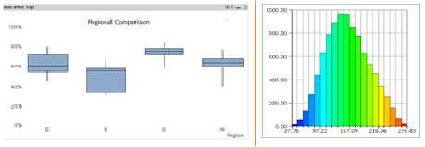
Continuous Variables
For continuous variables, we need to understand their central tendency and spread/dispersion.
The measures of central tendency are mean, median, mode, min, and max.
The measures of dispersion are range, IQR, variance, standard deviation, coefficient of deviation, skew, and kurtosis.
The visualization methods are histograms (frequency distribution) and box plots.
This analysis is also used to highlight missing and outlier values.

Slide 13
Measures of Central Tendency
A measure of central tendency is a summary measure that attempts to describe a whole set of data with a single value that represents the middle/center of its distribution. They are also known as summary statistics.
There are three main measures of central tendency: mode, median, and mean. Each of these measures offers a different approach to identifying the central value in the distribution.

Slide 14
Mean
The mean is the sum of the value of each observation in a dataset divided by the number of observations. This is also known as the arithmetic average.
Advantages
The mean can be used for both continuous and discrete numeric data, though is more often used with continuous data.
Limitations
The mean cannot be calculated for categorical data, as the values cannot be summed (though categorical data becomes discrete when you encode it). As the mean includes every value in the distribution, the mean is influenced by outliers and skewed distributions.

Slide 15
Median
The median is the middle value in a distribution when the values are arranged in ascending or descending order. When there are an odd number of values, the median is the middle value. When there are an even number of values, the median is the mean of the two middle values.
Advantages
The median is less affected by outliers and skewed data than the mean, and is usually the preferred measure of central tendency when the distribution is not symmetrical.
Limitations
The median cannot be identified for categorical nominal data, as it cannot be logically ordered. (These eventually become dummies and should be analyzed as categorical data.)

Slide 16
Mode
The mode is the most commonly occurring value in a distribution. There is no mode if there are two or more most commonly occurring values.
Advantages
It can be found for both numerical and categorical data, as the latter cannot have the mean or median calculated for it.
Limitations
In some distributions, i.e. when there is more than one mode, the mode does not reflect the center of the distribution. With continuous data, the distribution may have no mode. Binning continuous distributions may improve the mode in identifying the center of the distribution.

Slide 17
Measures of Dispersion
Measures of dispersion describe the spread of data values within the data.

Slide 18
Range
Range is the maximum value subtracted by the minimum value.
It is easy to calculate; however, it is most often less useful a measure of dispersion than standard deviation.

Slide 19
IQR
The data must be divided into quartiles of four equal parts. The values that divide each quarter are called the first, second and third quartiles (i.e. Q1, Q2 and Q3). The interquartile range is equal to Q3 – Q1.
Note that Q2 is also the median. Also note that, like with the median, if there are ever an even number of terms to be divided, average the two middle-most terms.

Slide 20
Variance

Slide 21
Standard Deviation

Slide 22
Coefficient of Deviation

Slide 23
Skew

Slide 24
Kurtosis

Slide 25
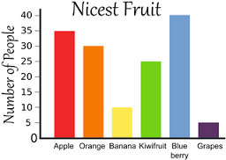
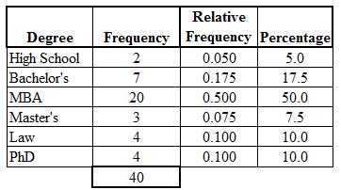
Categorical / Discrete Variables
For categorical variables, the distribution (or count) of each category is important. These can also be converted to percentages in each category, also known as count%.
Use a frequency table or bar graph to visualize the count. A pie chart can also be used to represent count%.

Slide 26
Minimum + Maximum
The minimum and maximum help to understand the possible range of values a distribution may take on to better interpret measures of central tendency and skew.

Slide 27
Distribution Shape + Measures of Central Tendency
When a distribution is symmetrical, the mode = median = mean in the center of the distribution.
When a distribution is skewed, the mean is generally pulled in the direction of the tails. Positive/right skew occurs when the majority of the data is on the left side of the distribution. Negative/left skew occurs when the majority of the data is on the right side of the distribution.
The median is usually the preferred measure of central tendency when the distribution is skewed, as it is not as affected by outliers and the mean in not in the middle of the distribution.

Slide 28
Outliers + Measures of Central Tendency
Outliers are extreme or atypical values that are notably different from the rest of the data. The mean is more sensitive to the existence of outliers than the median or mode.
Despite the existence of outliers in a distribution, the mean can still be an appropriate measure of central tendency, especially if the rest of the data is normally distributed.
Never remove an outlier from a dataset.

Slide 29
Note Missing Values
Though missing values are addressed in data cleaning / feature engineering, it is important to note missing values in this phase.

Slide 30
Categorical to Numerical – Encoding / Continuization
Refer to the categorical data slide in the feature engineering section.

Slide 31
Numerical to Categorical – Binning / Discretization
Refer to the binning slides in the feature engineering section.

Slide 32
Conclusions to Make
Are there missing values? How should they be dealt with?
Are there outliers?
Would feature engineering benefit any of these variables (noisy, combine, etc)?
What is the skew? What measure of central tendency is best to select given each variables features?
…

Slide 33
Bivariate Analysis
Bivariate analysis finds the relationship between two variables, looking for association and disassociation at a pre-defined significance (strength) level.
This analysis can be performed for any combination of continuous and categorical variables. The approach differs depending on the combination.
There are three types of bivariate analysis.

Slide 34
Continuous & Continuous
Use a scatter plot to visualize the relationship. A scatter plot shows the relationship between two variables but does not indicate its strength. This is usually drawn before working out a regression line. A way to present all possible scatter plots of two variables is in a scatter plot matrix.

Slide 35
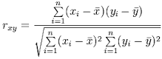
Continuous & Continuous Cont’d
To find the strength of the relationship, calculate its correlation. Correlation varies between -1 and +1, with -1 indicating a perfect negative linear correlation, +1 a perfect positive linear correlation, and 0 no correlation. Correlation is equal to the covar(X,Y) / sqrt(var(X) * var (Y)):
Strengths:
no relationship = -0.1 to 0.1
weak relationship = -0.35 to -0.1 or 0.1 to 0.35
moderate relationship = -0.6 to -0.35 or 0.3 to 0.65
strong relationship = < -0.6 or > 0.6

Slide 36
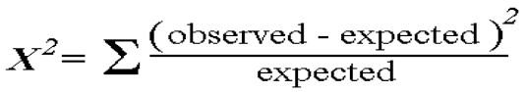
Categorical & Categorical
There are three methods to describe this relationship.
A two-way table has rows representing the category of one variable and columns representing the categories of the other. Each cell could contain count, count%, or both.
A stacked column chart adds the box plots/counts together and stacks one bar on top of the other. It could contain either count or count%.
A combination chart uses 2 or more chart types to emphasize that the chart contains different kinds of information. It’s the best visualization method to demonstrate the predictability power of a predictor (X-axis) against a target (Y-axis).
The Chi-Square Test derives the statistical significance of the relationship between the variables. It is based on the difference between the expected frequencies (e) and the observed frequencies (n) in one or more categories in the frequency table. It tests whether the evidence in the sample is strong enough to generalize to a larger population. It returns probability for the computed chi-square distribution with the degree of freedom. If the probability is 0 it indicates both categorical variables are completely dependent,1 shows both variables are completely independent, and less than 0.05 indicates the relationship between variables is significant at a 95% confidence level.
Statistical measures used to analyze the power of the relationship are 1) Cramer’s V for Nominal Categorical Variable, and 2) Mantel-Haenszed Chi-Square for ordinal categorical variable… ???

Slide 37
Categorical & Continuous
Draw box plots for each level of categorical variables to visualize. A line chart with error bars displays information as a series of data points connected by straight line segments. Each data point is the average of the numerical data for the corresponding category of the categorical variable with error bar showing standard error. It is a way to summarize how pieces of information are related and how they vary depending on one another. A combination chart uses two or more chart types to emphasize that it contains different kinds of information. You can put a bar chart for the category and line chart with percent in the target category, which is the best visualization method to demonstrate the predictability power of a predictor against a target.
Perform one of the following tests to assess whether each group is statistically significant/different from the others:
A z-test / t-test assess whether the mean of the two groups are statistically different from each other or not. This analysis is appropriate for comparing the averages of a numerical variable for two categories of a categorical variable. If the probability of z is small, then the difference of the two averages is more significant. The t-test is used over the z-test only when the number of observations for both categories is less than 30.
** Missing equations/full understanding

Slide 38
Categorical & Continuous Cont’d
An ANOVA assesses whether the average of more than two groups is statistically different from each other. This analysis is appropriate for comparing the averages of a numerical variable for more than two categories of a categorical variable.
** Missing equations/full understanding

Slide 39
Feature Engineering

Slide 40
Data Cleaning + Feature Engineering
Feature engineering is the process of transforming raw data into features that better represent the underlying problem to the predictive models, resulting in improved model accuracy on unseen data.
Better features means:
more flexibility in models (even less optimal ones will produce decent results).
simpler models (even less optimal parameters will produce decent results).
better results.

Slide 41
Feature Engineering Cont’d
Feature engineering can work to improve interpretation or accuracy, but not both. This relationship is a trade-off.

Slide 42
Missing Data
What can be done to fix the problem of missing data?
Ignore it – in the case of classification
Remove all rows with missing data – this can be dangerous because we may lose crucial data
Imputation – Replace missing values with measures of central tendency (mean*, median, mode) *most used
Imputation – Do the above, but subset the data so you only average certain, more applicable values from categorical/class variables
Fill missing data with the most probable values, inference-based like Bayesian formula or decision tree, essentially build a learning algorithm (note to use all same methods, so if you’re using linear regression to only include statistically significant variables)

Slide 43
Categorical data – Target-based Encoding
Categorical variables contain categories and must be changed into numbers to be fit to a statistical model. There are two approaches.
Target-based encoding: Convert each category to a number – only if there is an implied numerical significance, i.e. low = 0, medium = 1, high = 2. This should also be done for a boolean category (2 categories). Even binned age groups should more likely be converted to dummy variables.
Drawbacks to this method are that it’s dependent on the distribution of the target and it has a lower predictability power compared to the binary encoding method.

Slide 44
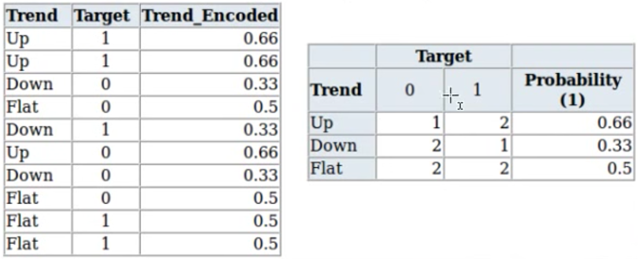
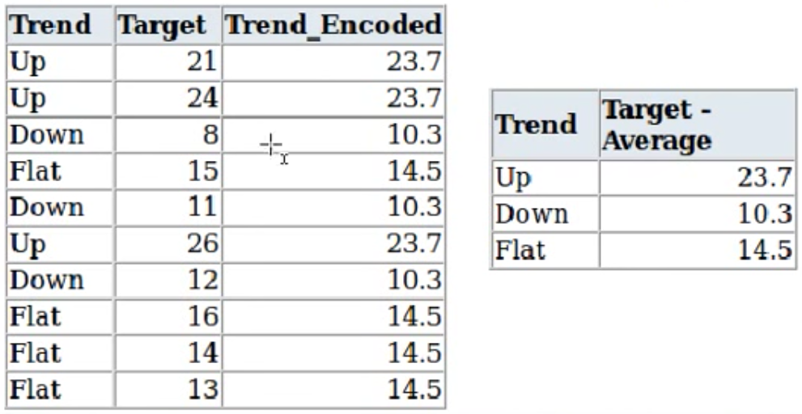
Target-Based Encoding Examples

Slide 45
Categorical data – Binary / Dummy Encoding
Binary encoding: Convert each category to a dummy variable (dummy encoding) – so that France either has a 1 or 0, Germany either has a 1 or 0, and you can get rid of Spain because 0 0 = Spain and you don’t want to fall victim to the dummy trap. Therefore, you should end up with # of categories – 1 = # of dummy variables. Reduces the risk of overfitting.
The main drawback of encoding is when categorical variables with many vaules tremendously increases the dimensionality of the data.

Slide 46
Binning / Discretization
Binning is the process of transforming numerical variables to categorical.
Transform a numerical variable into a categorical one by binning values (let’s say grades) into their respective categories (A, B, C, etc), usually based on frequency tables.
This will help interpretability and visualizations. It can reduce noise and/or non-linearity. Can also reduce risk of overfitting.
Best for regression models.
Binning often to create a more normal distribution, or to group a bunch of categories with a low percentage of of the rows into one category like ‘other’.
Binning allows easy identification of outliers, invalid and missing values of numerical variables.

Slide 47
Supervised Binning
Supervised binning methods transform numerical variables into categorical ones and refer to the target when selecting discretization cut points.
Entropy-based binning is one example of such a method. It uses a split approach and is based on the target. Intuitively, it finds the best split so bins are as pure as possible (the majority of the values in a bin have the same class label). Formally, it is characterized by finding the split with the maximal information gain.
Though the theory of how to create the splits, calculate entropy/information gain, etc is well-documented, it is out of scope to implement the algorithms oneself. Use preexisting libraries to do so. A full explanation of entropy-based binning can be found here and here.

Slide 48
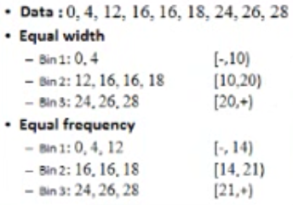
Unsupervised Binning
Unsupervised binning transforms numerical variables into categorical ones but does not use target information.
One method is equal width, which divides the data into k intervals of equal size. The width is determined by w = (max-min)/k, with the interval boundaries lying at min+w, min+2w, …, min+(k-1)w
Another method is equal frequency, which divides the data into k groups where each group contains approximately the same number of values.
For both of these methods, the best way of determining k is by looking at the histogram and trying different intervals or groups.

Slide 49
Reducing Categorical Levels
When there are too many levels in one category, many levels may account for a high percentage of the data. A decision tree or random forest will likely be very impacted, placing too much importance on all bins as opposed to the most important ones.
Reduce the number of levels in the category.

Slide 50
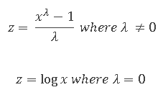
Non-Normal to Normal Distribution
Normally distributed data is useful for statistical analysis.
Use a transformation to obtain a normal distribution for tools/techniques that require a normal distribution.
This could involve taking the data’s log, square root, cube, etc, but testing all possibilities would be time consuming so could use a Box-Cox transformation (plug in lambda = -5 to +5):
Sometimes we can’t achieve normality with the Box-Cox method, so the resulting data should be checked to ensure normality is reached.
Can this reduce noise?

Slide 51
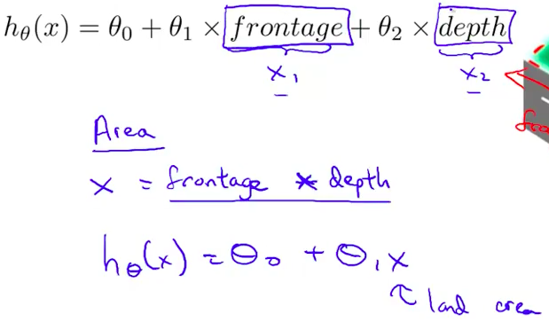
Interaction Terms
To understand the effect of two or more independent variables on the dependent variable jointly, create an interaction term.
No idea how to determine which variables should interact.
One variable should not depend on the other, and vice versa.

Slide 52
Reducing Dimensionality
Do not include any repetitive variables, or combine variables (i.e. get rid of length and width when creating an area variable).
The technique depends on the types of variables (text, image, numerical, etc).
Also called feature extraction.
Principal component analysis emphasizes variation to bring out strong patterns in a dataset.
Frequently used in image and video processing, and when there is a very large number of variables in a dataset.

Slide 53
Creating New Variables
Splitting a variable (i.e. a time into AM and PM) might have a higher predictive power.

Slide 54
Standardizing Units
Though (I believe) not fully necessary, converting all of the same units (i.e. all money to dollars) could benefit your interpretation of the model.

Slide 55
Additional Features
There is a possibility you will need to find additional data to build your model. Do it.

Slide 56
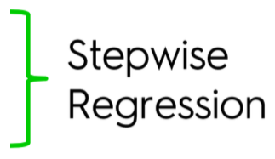
5 Methods of Building Models / Feature Selection
All in
Backward Elimination
Forward Selection
Bidirectional Elimination
Score Comparison
Does this only apply to linear regression? Polynomial/others too?
* These methods are considered controversial to statisticians, research others when you get some time?

Slide 57
All-In
Prior knowledge
You have to
Preparing for Backward Elimination

Slide 58
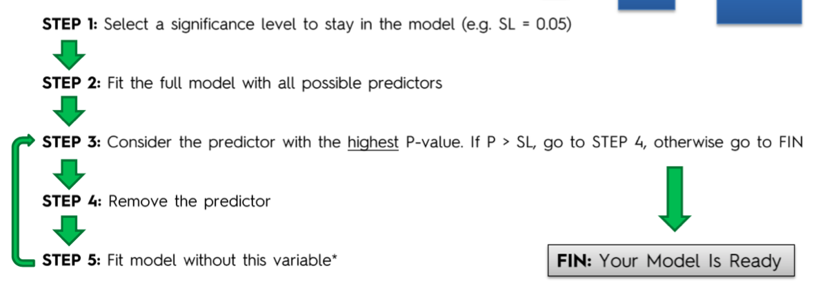
Backward Elimination

Slide 59
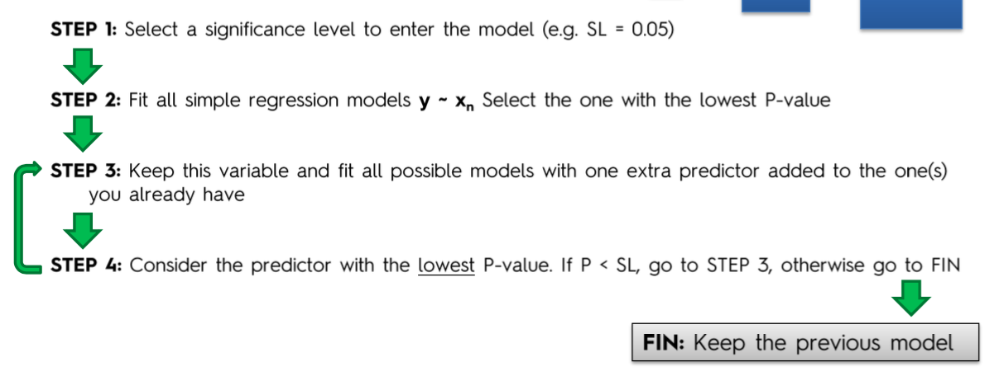
Forward Selection

Slide 60
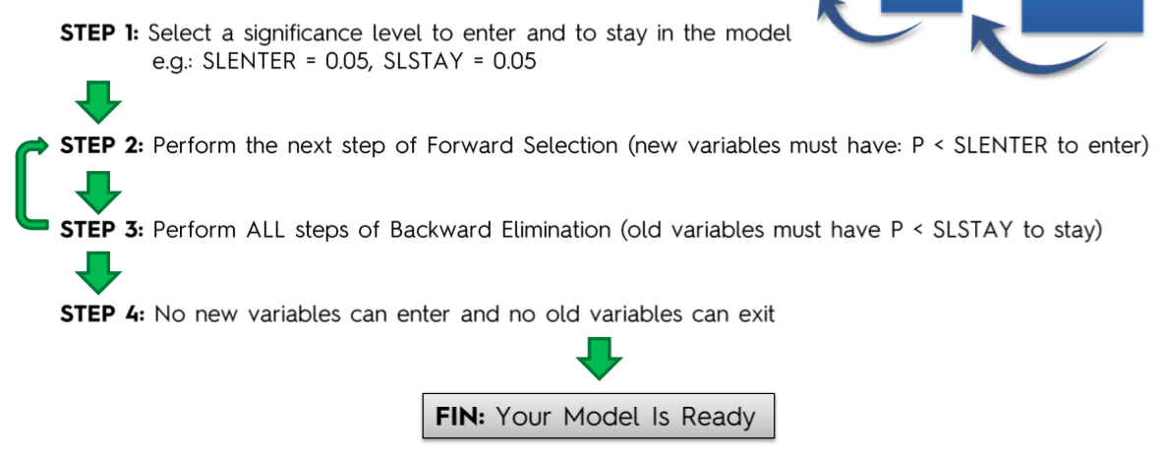
Bidirectional Elimination

Slide 61
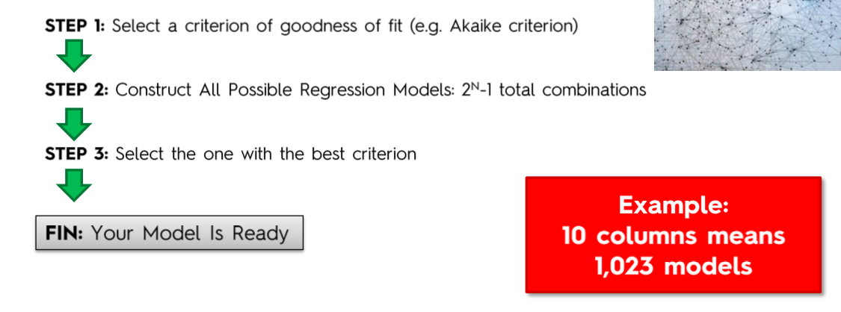
Score Comparison

Slide 62
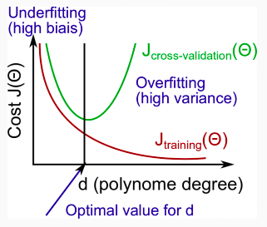
Polynomial Features?
As the polynomial order of a given features increases, training error will decrease. The cross validation error will tend to decrease as d increases up to a point, and then it will increase as d increases, forming a convex curve.

Slide 63
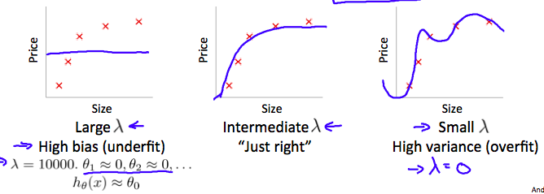
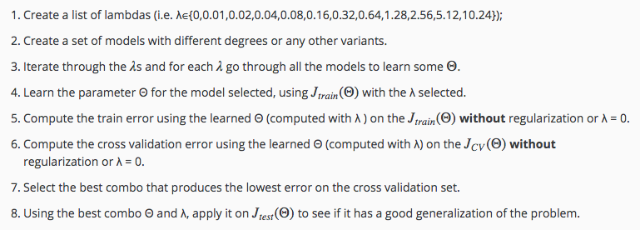
Regularization and Bias/Variance
Steps to choose both a model and a regularization term:

Slide 64
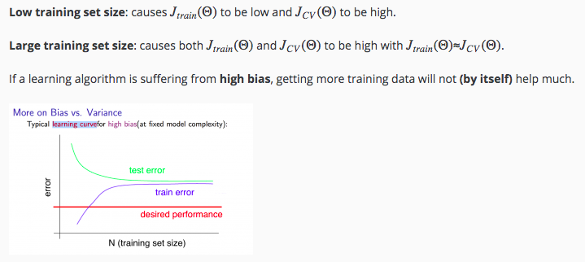
Learning Curves – High Bias

Slide 65
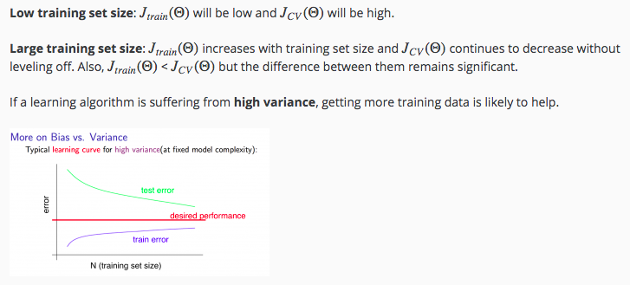
Learning Curves – High Variance

Slide 66
Fix High Bias and Variance
Fix high bias
Adding features
Adding polynomial features
Decrease lambda
Fix high variance
Get more training examples
Try smaller sets of features
Increase lambda

Slide 67
Train Test Validate Split
Split the data into training and testing sets.
Check the summary statistics of the training and testing sets to confirm they are randomized equally.
A test size of about 20-30% of the dataset is average if it’s only train test split.
Here is the data allocation for a train (60%), test (20%) and validate (20%) split.

Slide 68
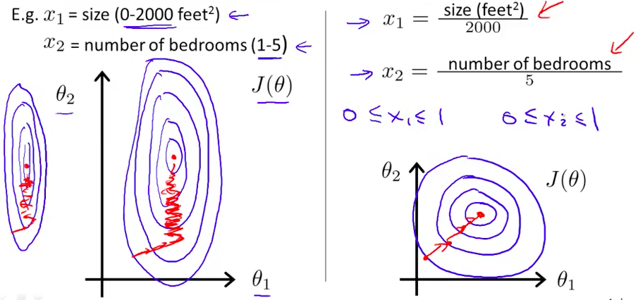
Feature Scaling
The skinnier the ellipses are, the harder it can be to find the global minimum. This is because theta will descend quickly on small ranges and slowly on large ranges, and so will oscillate inefficiently down to the optimum when the variables are uneven. Scale your features to make the ellipses more circular which will make convergence occur must faster. The goal is to make sure your features are on a similar scale around -1 ≤ x_{j}^{(i)} ≤ 1. This range doesn’t have to be precise.
Regression | Back

Slide 69
Feature Scaling
Many machine learning models are based on Euclidean distance (seems to help k-means clustering too), so having features with very different ranges will skew each feature’s importance. Feature scaling the dependent variables must be applied to both training and testing sets, using the same transformation on both. Two common approaches are:
Standardization (z-scores)
x_{stand} = x – mean(x)
std(x)
Normalization
x_{norm} = x – min(x) /
max(x) – min(x)

Slide 70
Feature Scaling
Standardization results in z-scores, which tell us the number of standard deviations away a given training example’s value is in the feature’s distribution. Normalization / min-max scaling scales the data to a range of around 0 to 1. The cost of having this bounded range (unlike with standardization) is that it results in smaller standard deviations which can suppress the effect of outliers.
There is no core difference between the two in terms of results, both work well. Python and R apply a mixed feature scaling method.
In clustering analysis and PCA, standardization is a clear better option because they rely on distance measurements and variance, respectively. In image processing and neural networks, normalization is a better option because images require a range (0 to 255) and neural networks often require a 0-1 scale.
Should you scale your dummy/dependent variables or not? That’s up for debate, but the tradeoff is that with scaling, you lose interpretability and without you lose accuracy.
Should you scale your independent variable? If it’s a classification problem, no. Under certain conditions, you should… Mixed feelings.
http://sebastianraschka.com/Articles/2014_about_feature_scaling.html

Slide 71
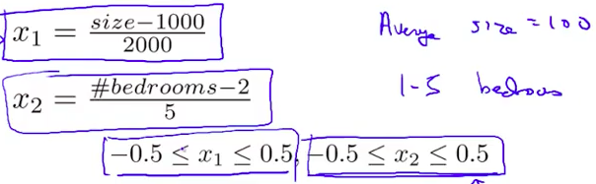
Mean Normalization
To perform mean normalization, replace x_{i} with (x_{i} – u_{i}) / s_{i} to make features have approximately zero mean. s_{i} is either the range (max – min) or standard deviation.
Regression | Back

Slide 72
Model the Data

Slide 73
Machine Learning (Model the Data)
Data cleaning + Feature engineering
Train-test split
(Optional) Feature scaling
Machine learning: create + fit model
Cross-validation
Model selection

Slide 74
machine learning
Machine learning is the science of getting computers to learn without being explicitly programmed.
A computer program is said to learn from experience E with respect to some class of tasks T and performance measure P, if its performance at tasks in T, as measured by P, improves with experience E.
Do you have labels (y values) in your dataset?
Yes
No
Supervised learning
Unsupervised learning
Back

Slide 75
Supervised Learning

Slide 76
Supervised learning
Supervised learning means you want to provide the most “right” answers. Using a dataset with features (x-values) and a target (y-value), we attempt to predict y given x and our model.
Are you predicting a continuous or discrete output?
Continuous
Discrete
Regression
Classification
Back

Slide 77
Regression

Slide 78
Regression
Regression trains a dataset’s features (x-values) to predict it’s continuous target (y-value).
Key
m – number of training examples
n – number of features
x – features/input variables
y – target/output variable
(x,y) – one training example
x^{i},y^{i} – i^{th} training example
x_{j}^{i} – value of feature j in i^{th} training example
h – hypothesis
theta – parameters that provide different hypothesis/predicted y-values
J(theta) – cost of theta
alpha – learning rate
Model Cost Function Minimizing the Cost Function
Back

Slide 79
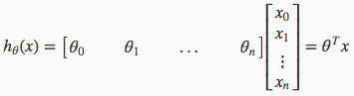
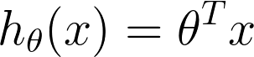
Model – Regression
Multivariate linear regression
Vectorized implementation
where x₀^{(i)} = 1
Regression | Back | Continue

Slide 80
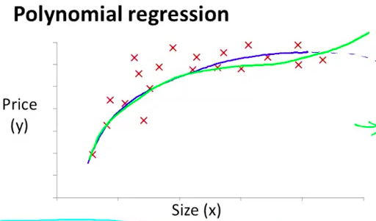
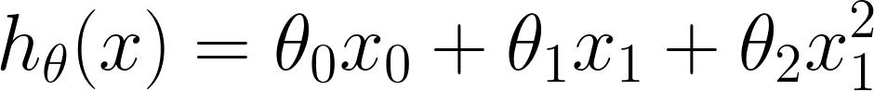
Model – Regression
The blue line represents the first polynomial regression and the green line represents the second.
Feature scaling becomes increasingly important with polynomial regression because the range of those features increases exponentially.
Regression | Back
Notes:
cube is wrong
interaction terms? does that happen here or in data cleaning?
missing a section on how to select the best regression model (multivariate and polynomial), this would fill in a big gap for me

Slide 81
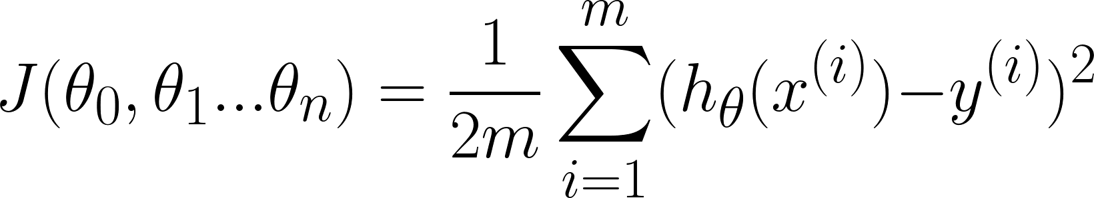
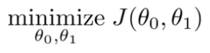
Cost Function - Regression
We take the square because it amplifies bigger errors so we can see them, we can use a vectorized implementation which is not computationally expensive, and the partial derivative of cost is defined at all theta values. We don’t use absolute values because its gradient is undefined at zero. We don’t use a higher order square because it would be more computationally expensive than a square.
The objective of the cost function is to minimize the sum of the squared differences between the hypothesis and actual target values. In other words, the goal is to minimize the squared error function. The below is the squared error function or mean squared error:
Goal:
Remember, the hypothesis is equal to the model’s equation.
The mean is halved as a convenience for the computation for the gradient descent, as the derivative term of the square function will cancel out the ½ term.
Link to in-depth resource on the following: We multiply our MSE cost function my ½ so that when we take the derivative, the 2s cancel out. Multiplying the cost function by a scalar does not affect the location of its minimum, so we can get away with this.
Alternatively, you could think of this as folding the 2 into the learning rate. It makes sense to leave the 1/m term, though, because we want the same learning rate (alpha) to work for different training set sizes (m).
Regression | Back | Continue

Slide 82
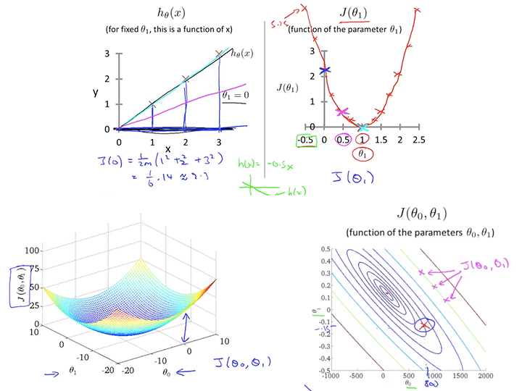
Cost Function Intuition - Regression
The intuition of the cost function is that there is a global minimum at which the cost of theta is minimized by a specific combination of thetas. This results in a convex or bowl-shaped graph.
Regression | Back

Slide 83
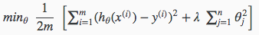
Regularized Cost Function
To fix the problem of overfitting, one possible solution is to use the regularized cost function which reduces the effect of polynomial thetajs. Lambda is the regularization parameter. This smooths the output of the regression.
If lambda is too large, it may smooth out the function too much and cause underfitting.

Slide 84
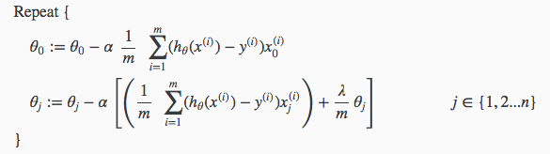
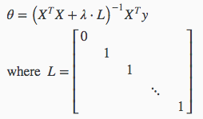
Regularized Gradient Descent / Normal Equation
Gradient descent – Separate theta0 because we don’t want to penalize it:
Update rule:
Normal equation – The equation stays the same except an addition to the term inside the parenthesis:
L, an identity matrix, should have the dimension (n + 1)(n + 1) and does not include x0. When we have this term, we don’t have to worry about non-invertibility.

Slide 85
Minimizing the Cost Function
To minimize the cost function of a (linear?) regression, you must consider a number of factors and choose the following:
Gradient Descent
Need to choose alpha
Needs many iterations
Works well even when n is large
Normal Equation
No need to choose alpha
Don’t need to iterate; just compute one vectorized equation
Slow if n is very large (beyond n = 10,000)
Regression | Back

Slide 86
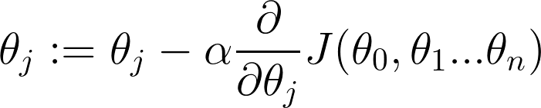
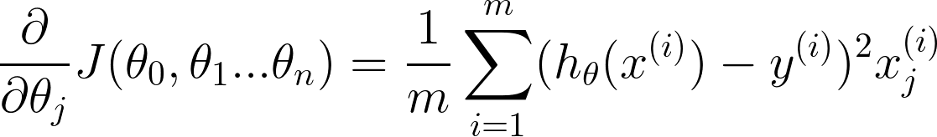
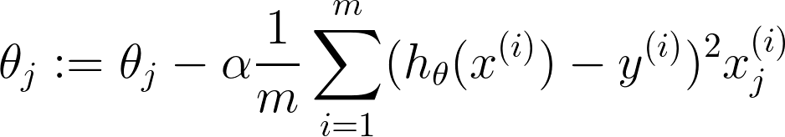
Gradient Descent - Regression
Gradient descent is the act of minimizing the cost function (as well as other kinds of functions). Initialize each theta value and step through until a minimum is reached. Local minimums can also be reached depending on where the thetas are initialized.
where := is assignment
where x₀^{(i)} = 1
Regression | Back | Continue

Slide 87
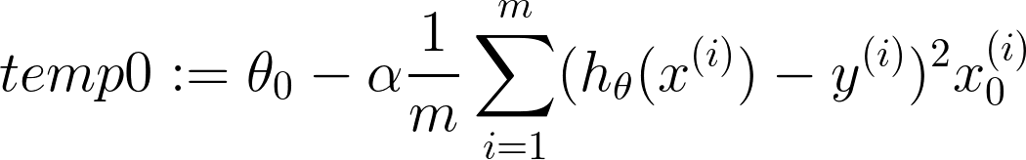
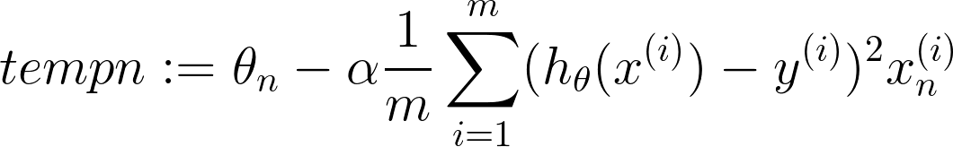
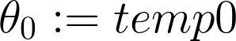
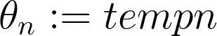
Gradient Descent - Regression
Using simultaneous updates, step until convergence is reached
where := is assignment
Regression | Back | Continue

Slide 88
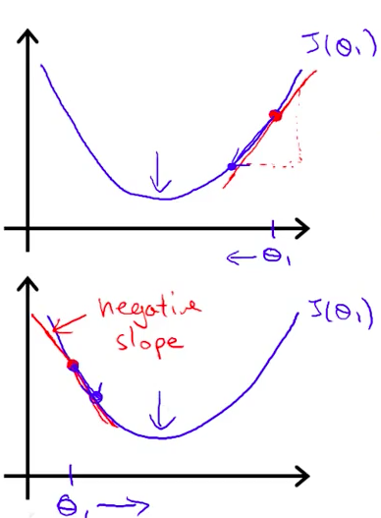
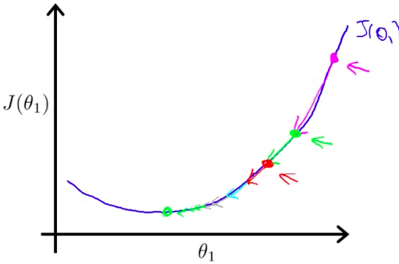
Gradient Descent Intuition - Regression
If the learning rate alpha is too small, gradient descent can be slow. If it’s too large, gradient descent can overshoot the minimum and fail to converge or even diverge (increase).
The derivative will find the slope of a line that is tangent to the function. If the slope is positive, the derivative is positive and vice versa. If the slope is positive, you need to decrease theta and vice versa.
If you initialize at a local optima, theta will remain unchanged because the slope of the line is 0 thereby making the derivative/cost portion 0 and leaving theta equal to itself.
At the minimum, the derivative will always be 0 and thus we get: theta1 := theta1 – alpha * 0
As gradient descent approaches a local minimum, it will automatically take smaller steps. So, there is no need to decrease alpha over time.
Regression | Back | Continue

Slide 89
Gradient Descent
In batch gradient descent, each step of gradient descent uses all training examples. This is the gradient descent learned so far.
Other types?

Slide 90
Gradient Descent Help
To remedy issues involving poor gradient descent results, consider the following common solutions:
Feature Scaling | Mean Normalization | Learning Rate | Examine Features
Regression | Back

Slide 91
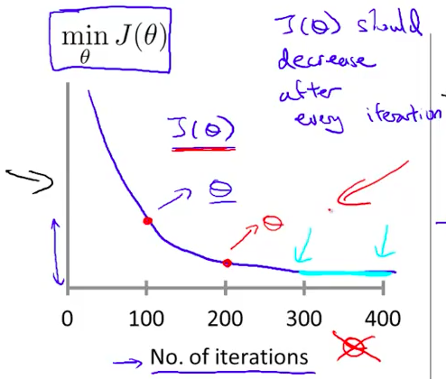
Learning Rate
The cost of thetas should decrease after every iteration, which indicates a sufficiently small alpha. If alpha is too small, gradient descent can be slow to converge. Is alpha is too large, the cost of thetas could increase and this graph would have strange patterns.
Regression | Back | Continue
Notes:
*When did we start using one theta to represent the theta vector?

Slide 92
Learning Rate
To select alpha, test each rate starting with 0.001 and multiply it by 3 to look for the fastest decrease in cost. See where alpha is two large, then take a step or two back.
0.001 0.003 0.01 0.03 0.1 0.3 1
Regression | Back
Notes:
*When did we start using one theta to represent the theta vector?

Slide 93
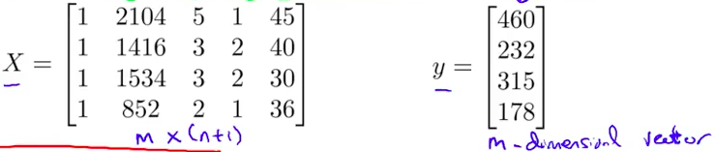
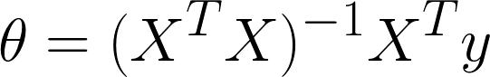
Normal Equation
Normal equation is another method to minimize the cost function, but analytically. The notes in this presentation only pertain to the linear regression model. Minimize J by explicitly taking its derivatives with respect to the thetaj’s and setting them to zero. This means the optimum theta can be found without iteration. There is no need to do feature scaling using the normal equation.
The below equation solves for a vector of thetas.
Vectorized implementation
Regression | Back | Continue

Slide 94
Normal Equation – Non-invertibility
X^{T}X being non-invertible is caused by:
redundant features (those that are linearly dependent)
fix is to delete them: x₁ = size in feet² and x₂ = size in m²
too many features (i.e. m ≤ n)
fix is to delete some features or use regularization
Regression | Back

Slide 95
Practical Notes
How to create a simple linear regression:
Create object / fit model
Check regressor’s summary statistics to get coefficients and p-values (closer to 0 the better?)
Visualize your model

Slide 96
Linear Regression Assumptions
Linearity – The relationship between independent and dependent variables must be linear. This is best checked with a scatter plot.
Homoscedasticity – The error terms along the regression are equal. This is best checked with a scatterplot. The Goldfeld-Quandt test can test for heteroscedasticity, which splits the data in high and low value to see if the samples are significantly different. A non-linear correction might fix this problem.
Multivariate normality – The error terms should be normally distributed (not the dependent variables). This is best checked with 1) a histogram and fitted normal curve of a Q-Q-Plot, or 2) a goodness of fit test like the Kolmogorov-Smirnof test. A possible fix is a log transformation, but it can introduce effects of multicollinearity.
Independence of errors – There should be little or no autocorrelation, which occurs when the residuals are not independent from each other (aka when y(x+1) is not independent from y(x)). Test using the Durbin-Watson’s d test where 1.5 < d < 2.5 shows no autocorrelation.
Lack of multicollinearity (dummy variable trap = creating same number of dummy variables as categories creates multicollinearity because one variable directly predicts another) – This occurs when independent variables are not independent of each other and the error of the mean has to be independent from the independent variables. There are four ways to test for multicollinearity:
Correlation Matrix – compute the matrix of Pearson’s Bivariate Correlation among all independent variables and the correlation coefficients need to be smaller than 1.
Tolerance – measure the influence of one independent variable on all other independent variables by running an initial linear regression where T = 1 – R^2 where T < 0.1 there might be be multicollinearity and T < 0.01 there certainly is.
Variance Inflation Factor (VIF) – equals 1 / T. With VIP > 10 there is an indication for multicollinearity and VIP > 100 there certainly is.
Condition Index – calculated using a factor analysis on independent variables where 10-30 indicates mediocre multicollinearity and >30 strong multicollinearity.

Slide 97
Support Vector Regression
???

Slide 98
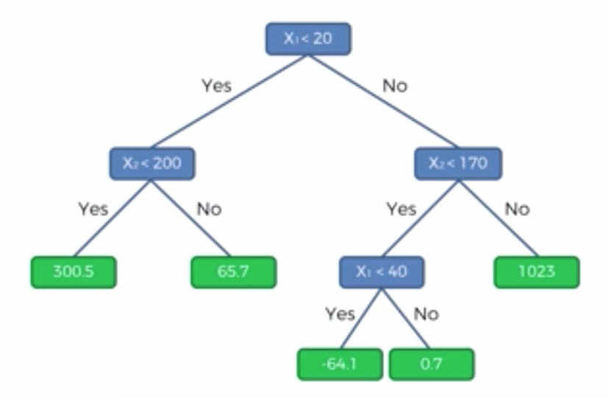
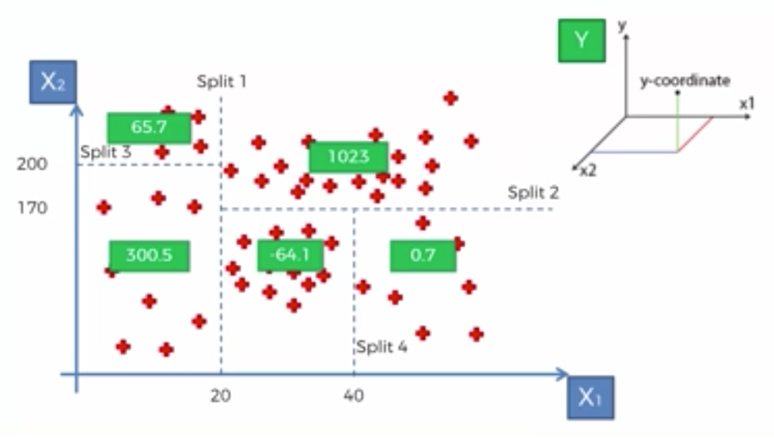
Decision Tree Regression

Slide 99
Ensemble Learning
Definition, before decision tree

Slide 100
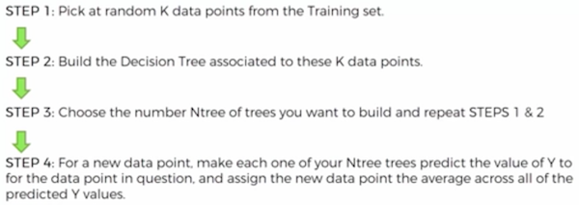
Random Forest Regression

Slide 101
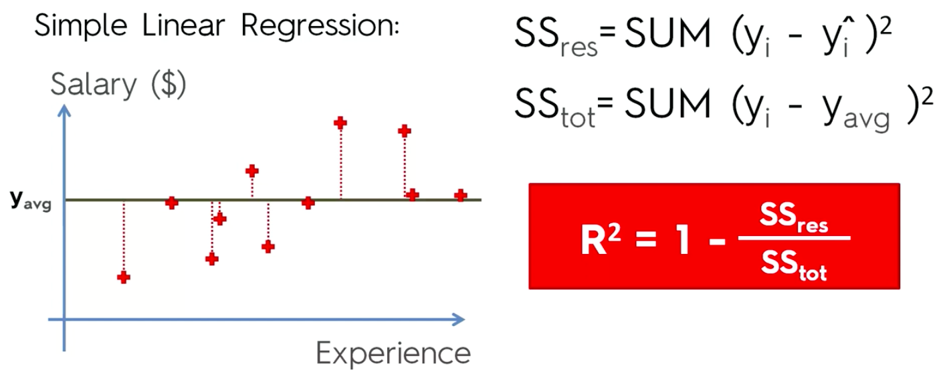
R^2

Slide 102
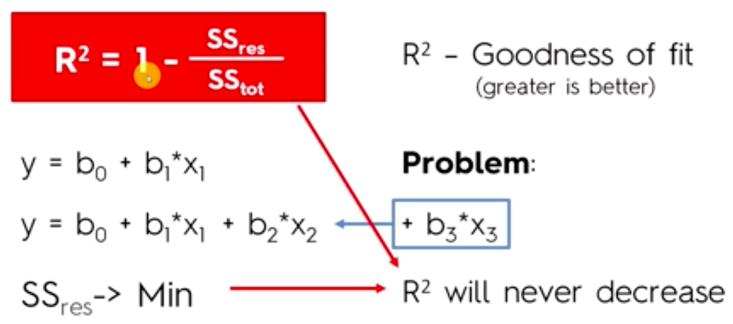
R^2 Problem

Slide 103

Adjusted R^2

Slide 104
Interpreting Coefficients
For every unit increase of the independent variable, the dependent variable increases by the coefficient.
Be aware, the units of each variable may be very different. So, making a more sweeping assumption about which variable has a greater impact wouldn’t make sense unless the two compared variables are on the same scale.

Slide 105
Classification

Slide 106


Classification
In a classification problem, y-values are discrete. This means they can take either a binary classification (negative and positive) or multiple classes.
or
Key
m – number of training examples
n – number of features
x – features/input variables
y – target/output variable
(x,y) – one training example
x^{i},y^{i} – i^{th} training example
x_{j}^{i} – value of feature j in i^{th} training example
h – hypothesis
theta – parameters that provide different hypothesis/predicted y-values
J(theta) – cost of theta
Model Cost Function Optimization Algorithms
Multiclass Classification Overfitting Regularization

Slide 107


Model - Classification

Slide 108
Unsupervised Learning
Unsupervised learning occurs when we do not have y-labels and therefore do not have an explicit way to handle the data. You must find its structure.
Clustering

Slide 109
Communicate and Visualize Results
This could include:
Paper
Presentation
PDF
Visualizations and conclusions
Ensuring results are in the right hands
Following up on implementations impacted by the results

Slide 110
Unsupervised Learning

Slide 111
Unsupervised Learning
Unsupervised learning allows us to approach problems with little or no idea what our results should look like. We can derive structure from data where we don’t necessarily know the effect of the variables. There is no feedback based on the prediction results.
Clustering vs Non-clustering?

Slide 112
Dimensionality Reduction

Slide 113
PCA Overview
Principal component analysis (PCA) reduces the dimensionality of a dataset by compressing correlated features. It tries to find a lower dimensional surface so that the sum of squares (error) is minimized.
Data compression decreases the amount of data used and speeds up learning algorithms.
Data visualization takes resulting z features and plots them to compare training examples.
Note that PCA is not linear regression because in linear regression we are minimizing by the mean squared error (vertical) and PCA is minimizing the projection error (diagonal). There is also no dependent variable in PCA.

Slide 114


PCA
Be sure to perform mean normalization and feature scaling before PCA. Also make sure you have not created a b0 column to 1 yet.
Reduce from n-dimension to k-dimension: find k vectors u(1), u(2),…,u(k) onto which to project the data so as to minimize the projection error. To do this, compute the covariance matrix:
There is another function eig(Sigma). Either way, plug Sigma into it and get matrix U with all the vectors from which we take the first k columns and calculate:

Slide 115

Choosing K
It’s also common to retain 95% of the variance.

Slide 116

Choosing K - Algorithm
Can 1) guess and check, or 2) use S matrix to calculate more efficiently:

Slide 117
Best Practices
Be sure to perform mean normalization and feature scaling before PCA. Also make sure you have not created a b0 column to 1 yet.
PCA should be performed on all sets (train, validate and test).
Don’t use PCA to reduce overfitting. Use regularization instead.
Run the learning algorithm without PCA before implementing it. Only if that doesn’t do what you want, then consider using PCA.

Slide 118

Reconstruction
If you want to reconstruct the features derived from PCA, you can approximate them by reversing the equation:

Slide 119
After Machine Learning

Slide 120

Train Test Validate Split / Fit
After applying a learning algorithm to the train set, use the cross-validation set to tune the model. In the case of polynomial regression, find the polynomial degree with the least error by training each hypothesis and calculating its cross validation error.
Then, test the model on the test set and see how well the model generalizes (or if it over/underfits) by computing the test set error.
Underfitting, or high bias, occurs when the hypothesis maps poorly to the trend of the data. This is usually caused by a hypothesis that is too simple or uses too few features.
Overfitting, or high variance, occurs when the hypothesis fits the training data well but does not generalize to predict new data well. This is usually caused by an overly complicated function that attempts to explain non-trends.

Slide 121
Fix Over/Underfitting
The best options to fix over/underfitting with regression are:
Reducing the number of features – either manually or using a model selection algorithm (PCA?)
Regularization – keep all features but reduce the magnitude of parameters thetaj, works well when there are a lot of slightly useful features

Slide 122
Linear Algebra Review

Slide 123

Matrices
A matrix is a rectangular array of numbers written between square brackets. The dimension of a matrix is the number of rows x number of columns.

Slide 124

Matrix Elements
Matrix elements are entries of a matrix. By convention, matrices are referred to with upper case letters (i.e. X).

Slide 125

Vectors
A vector is a matrix with one column, or a n x 1 matrix, or an n-dimensional vector. By convention, vectors are referred to with lower case letters (i.e. y).

Slide 126

Matrix Addition
To add matrices, they must be the same dimensions and will result in a matrix of the same dimension.

Slide 127

Scalar Multiplication
Multiply or divide each number inside the matrix by the scalar. The result should have the same dimensions as the original matrix.

Slide 128

Combination of Operands
Respect PEMDAS.

Slide 129

Matrix Vector Multiplication

Slide 130

Example

Slide 131

Applied Example
This vectorized implementation is shorter, simpler and more efficient when coding.

Slide 132

Matrix Matrix Multiplication

Slide 133

Example

Slide 134

Applied Example

Slide 135

Not Commutative
Matrix matrix multiplication is not commutative, and can even result in a matrix with different dimensions.

Slide 136

Is Associative

Slide 137

Identity Matrix

Slide 138

Matrix Inverse
Use numerical software to compute the inverse of matrices. If a matrix is all zeros it doesn’t have an inverse. There are a few others, but that’s out of scope. Matrices that don’t have an inverse are sometimes called singular or degenerate.

Slide 139

Matrix Transpose

Slide 140
Appendix

Slide 141
Data Preprocessing
Steps:
Get the dataset
Import the libraries
Import the dataset
Identify independent + dependent variables
Missing data
Categorical data
Splitting the dataset into training + testing sets
Feature scaling
(Optional) Visualize your data
Notes:
From Machine Learning A-Z (Udemy)

Slide 142
Data Preprocessing (2)
Data cleaning – fix missing data, smooth noisy data, identify/remove outliers, resolve inconsistences
Data integration – integrate multiple databases
Data transformation – normalization and aggregation
Data reduction – obtain reduced representation in volume but produce similar analytical results
Data discretization – part of data reduction but with particular importance, especially for numerical data
* Pulled from outside resource

Slide 143
Data Cleaning
Data acquisition and metadata
Fill in missing values
Unified date format
Converting nominal to numeric
Identify outliers and smooth out noisy data
Correct inconsistent data
* Pulled from outside resource

